Slide 1
Goal 2.1.3

Slide 2
EEn.2.1.3 Explain how natural actions such as weathering, erosion (wind, water and gravity), and soil formation affect Earth’s surface.

Slide 3
Weathering http://www.ux1.eiu.edu/~cfjps/1300/weathering.html
Mechanical/physical
chemical
http://www.classzone.com/books/earth_science/terc/content/visualizations/es1201/es1201page01.cfm?chapter_no=visualization
http://www.geolsoc.org.uk/ks3/gsl/education/resources/rockcycle/page3564.html

Slide 4
Erosion: movement of rocks and sediment
http://www.geography4kids.com/files/land_erosion.html
Factors: gravity, water, wind

Slide 5
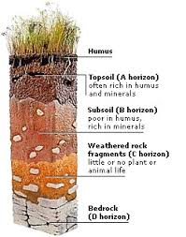
Soil
Made of particles of rocks and minerals, organic matter, water, and air
Water moves slowly through smaller, more tightly packed sediments (like clay)

Slide 6
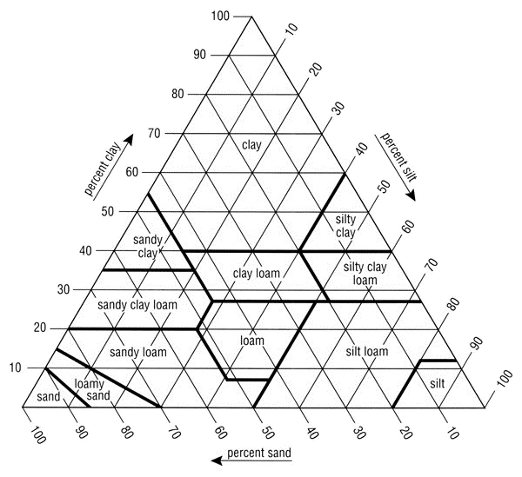
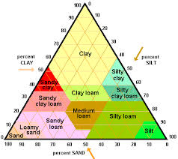
Soil triangle

